Slide 1


The Future is Now: AutoML and its Applications
Presenter: Jisoo Mok
Notes:
머신러닝 전문가가 아닌 모두가 쓸수 있는 AI. -> 선한영향력

Slide 2
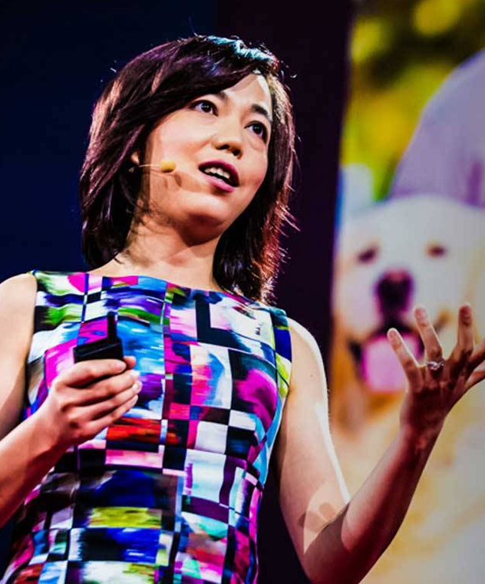
“We are embarking on a mission to democratize AI.”
Fei Fei Li, 2018

Slide 3


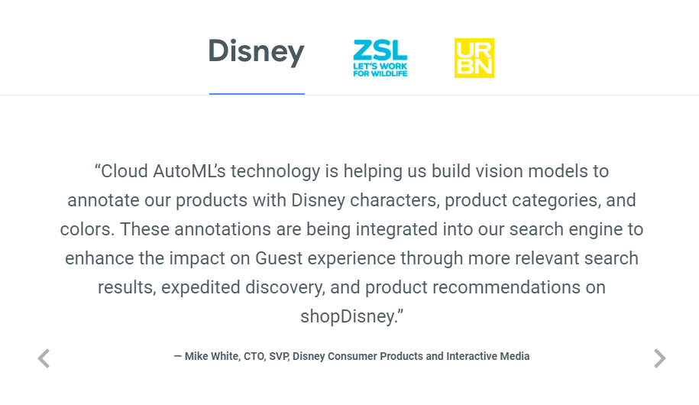
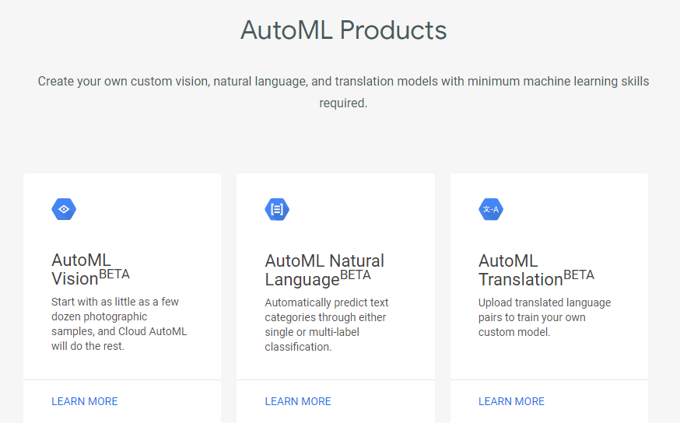
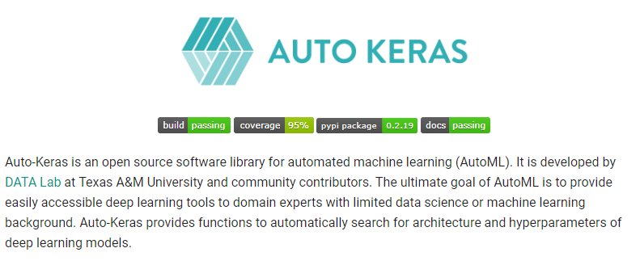
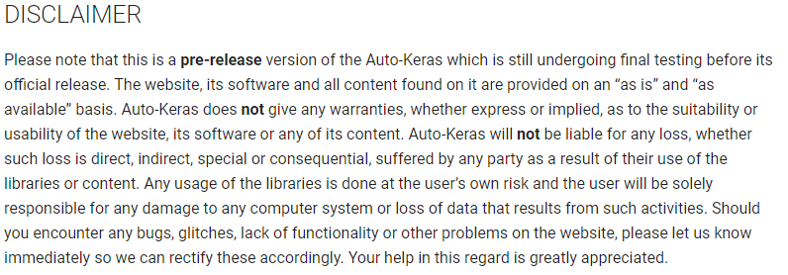
Available AutoML APIs and Libraries
Notes:
Not entirely reliable

Slide 4
Table of Contents
Introduction: Why AutoML?
Neural Architecture Search Techniques
Evolutionary Algorithm
Reinforcement Learning
Gradient- Based Optimization
Applications of NAS
Computer Vision
Auto-DeepLab [Image Segmentation]
NAS-FPN [Object Detection]
AutoGAN [Image Generation]
Network Size Reduction
Platform-aware Network Design
Neural Network Pruning
Conclusion

Slide 5
Table of Contents
Introduction: Why AutoML?
Neural Architecture Search Techniques
Evolutionary Algorithm
Reinforcement Learning
Gradient- Based Optimization
Applications of NAS
Computer Vision
Auto-DeepLab [Image Segmentation]
NAS-FPN [Object Detection]
AutoGAN [Image Generation]
Network Size Reduction
Platform-aware Network Design
Neural Network Pruning
Conclusion

Slide 6
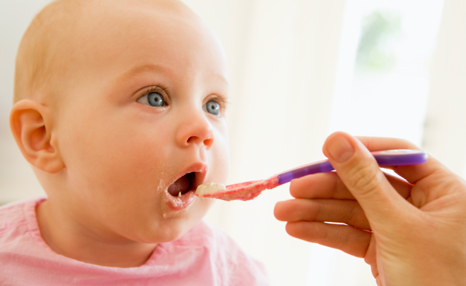
Challenges in Traditional Deep Learning
NETWORK DESIGN
HYPERPARAMETER TUNING
ADAPTABILITY
NEURAL ARCHITECTURE SEARCH
HYPERPARAMETER OPTIMIZATION
META-LEARNING
Notes:
애키우듯 키우는 소중한 뉴럴넷..

Slide 7

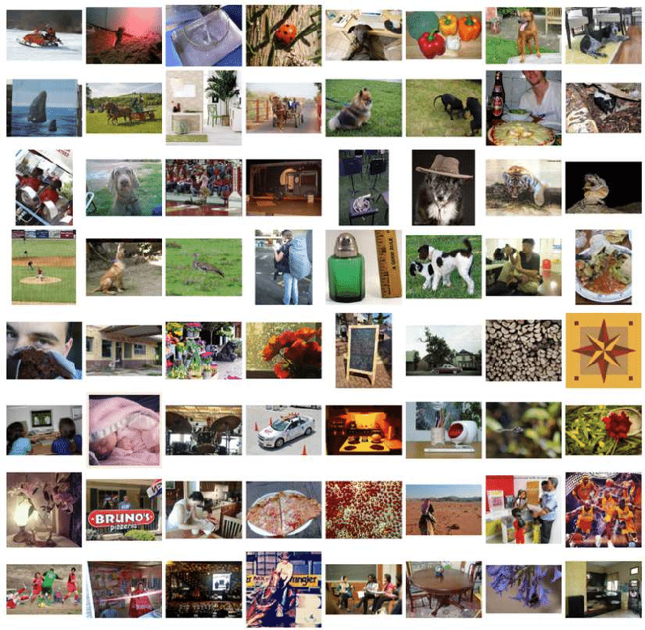


Neural Architecture Search (NAS)
Deep Neural Network
Input Data
Network Design
Hyperparameter Tuning
Iterative Training
Train
Test
Fine-tune
also known as Neural Architecture Search [NAS]
Notes:
Developed to alleviate these problems that engineers face everyday; instead of manually designing

Slide 8
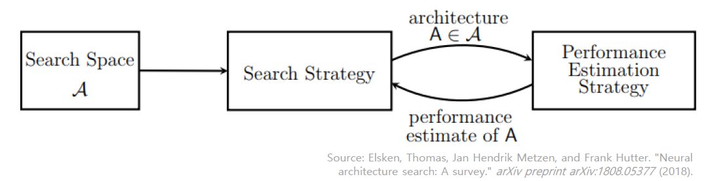
Three Dimensions of NAS
Search Space
Which architectures can be represented?
Search Strategy
How should we explore the search space?
Performance Estimation Strategy
Can we estimate the performance of an architecture on unseen data?

Slide 9
The NAS Family Tree
Neural Architecture Search
Evolutionary Algorithm
Reinforcement Learning
SMBO
Gradient-based Optimization
Large-Scale Evolution of Image Classifiers (ICML, 2017)
Regularized Evolution for Image Classifier Architecture Search (arXiv, 2018)
Neural Architecture Search with Reinforcement Learning (ICLR, 2017)
Efficient Neural Architecture Search via Parameter Sharing (ICML, 2018)
Progressive Neural Architecture Search (ECCV, 2018)
Differentiable Architecture Search (ICLR, 2019)
Others…
Using Hypernetworks
Random Search
Bayesian Optimization
DARTS
NAS
PNAS
AmoebaNet
ENAS
Notes:
Researchers have adopted and experimented with many pre-existing algorithms, such as
Today, I’ll be covering the basics of RL-based NAS

Slide 10
Table of Contents
Introduction: Why AutoML?
Neural Architecture Search Techniques
Evolutionary Algorithm
Reinforcement Learning
Gradient- Based Optimization
Applications of NAS
Computer Vision
Auto-DeepLab [Image Segmentation]
NAS-FPN [Object Detection]
AutoGAN [Image Generation]
Network Size Reduction
Platform-aware Network Design
Neural Network Pruning
Conclusion

Slide 11
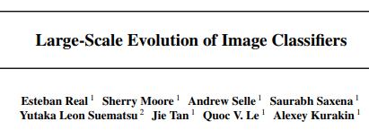
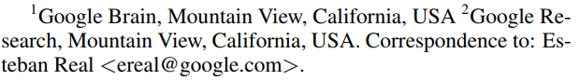
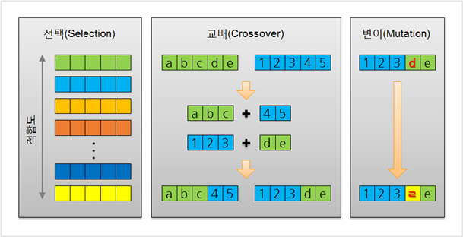
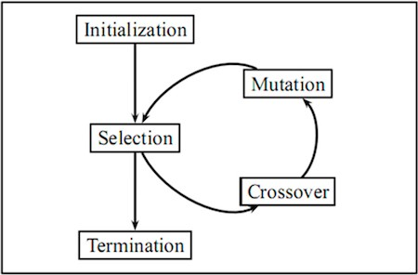
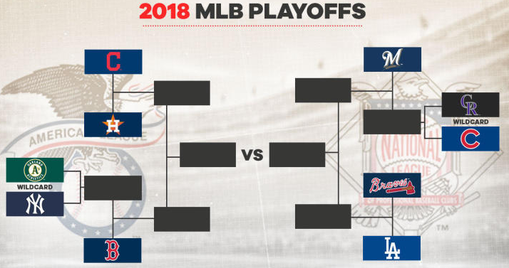
Large-scale Evolutionary Algorithm
ICML, 2017
Evolutionary Algorithm
Tournament Selection
fitness
Source: https://www.cbssports.com/mlb/news/2018-mlb-playoffs-bracket-is-set-after-brewers-dodgers-win-division-tiebreakers/
Source: http://versusall.tistory.com/entry/유전-알고리즘-2-유전-연산자의-종류
https://towardsdatascience.com/introduction-to-evolutionary-algorithms-a8594b484ac
Notes:
Start with a single layer architecture without convolution
Algorithm의 simplicity 때문 can it really work?

Slide 12
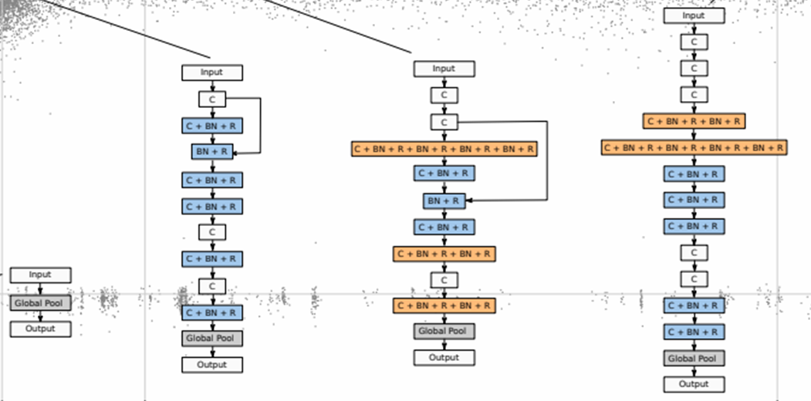
Large-scale Evolutionary Algorithm
ALTER-LEARNING-RATE
IDENTITY
RESET-WEIGHTS
INSERT/REMOVE-CONVOLUTION
ALTER-STRIDE / FILTER-SIZE / # OF CHANNELS
ADD/REMOVE-SKIP
Source: https://towardsdatascience.com/introduction-to-evolutionary-algorithms-a8594b484ac
Notes:
no fixed depth, arbitrary skip connections, and few restrictions on numerical parameters.
Similar to the actions that a human designer may take when improving an architecture.
Fairly unrestricted search space
Very little human intervention.

Slide 13

Large-scale Evolutionary Algorithm
Notes:
Large scale**

Slide 14
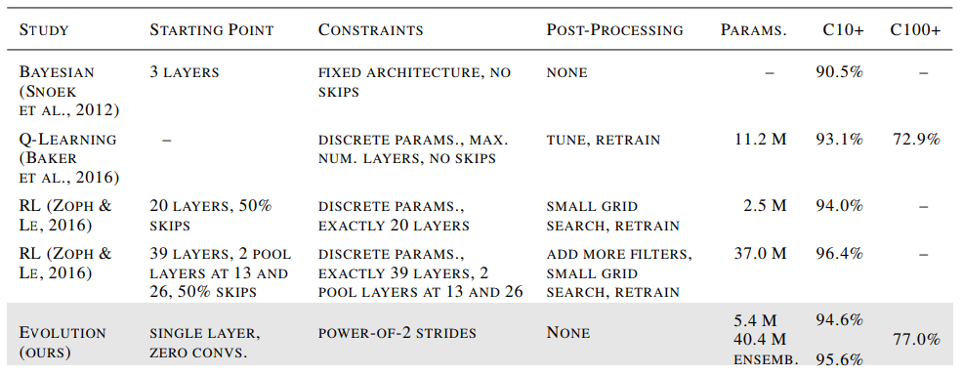
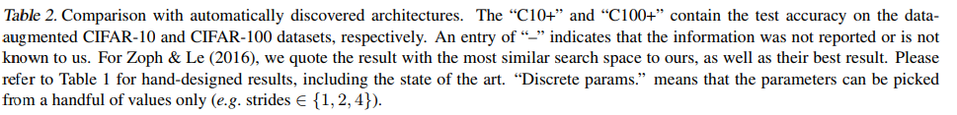
Large-scale Evolutionary Algorithm – Results
Notes:
Little to no human intervention

Slide 15
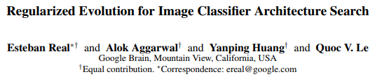
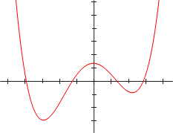

Aging Evolutionary Algorithm
arXiv, 2018
Super Fit Individual
Source: http://www.fmall.us/
Best Architecture
Notes:
Modify the tournament selection algorithm by introducing an age property.
Associate each model with an age -> bias the tournament selection to choose the “younger” model.

Slide 16
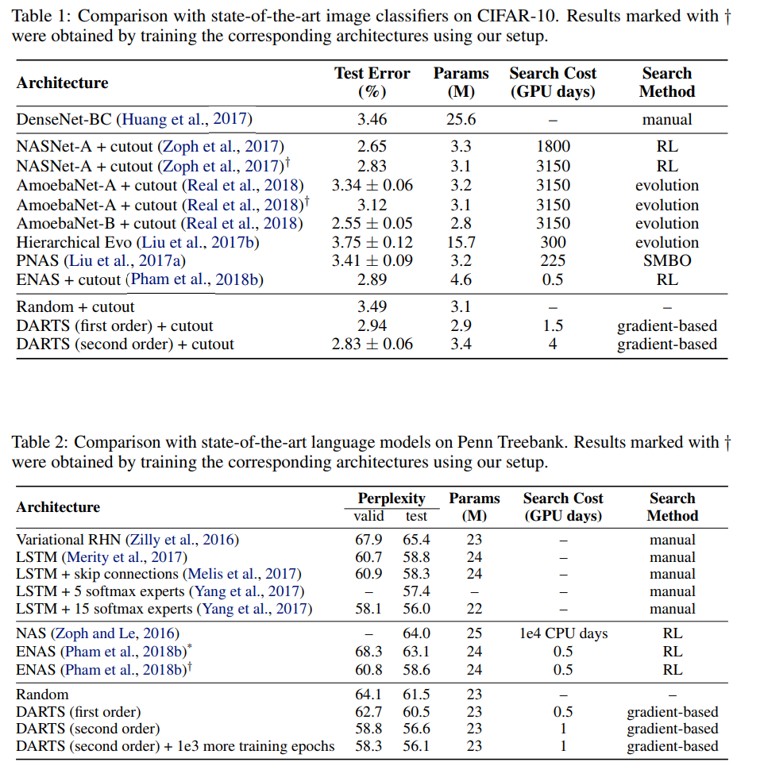
Aging Evolutionary Algorithm – Results
Notes:
NASnet not equal to RL it’s transfer learning
Transfer learning과 automl의 boundary 애매모호
Train with cifar 10 then test it on imagenet
Search space 자주쓰임
Training result benchmark로 씀

Slide 17
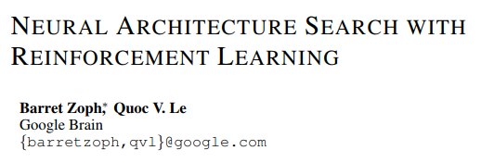
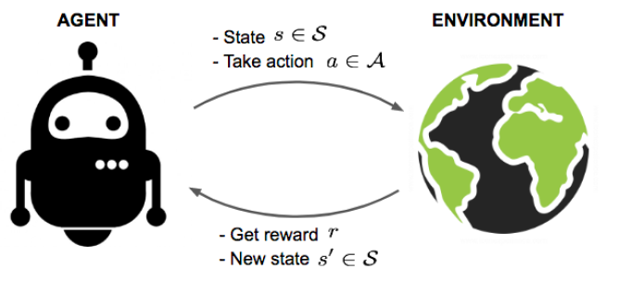
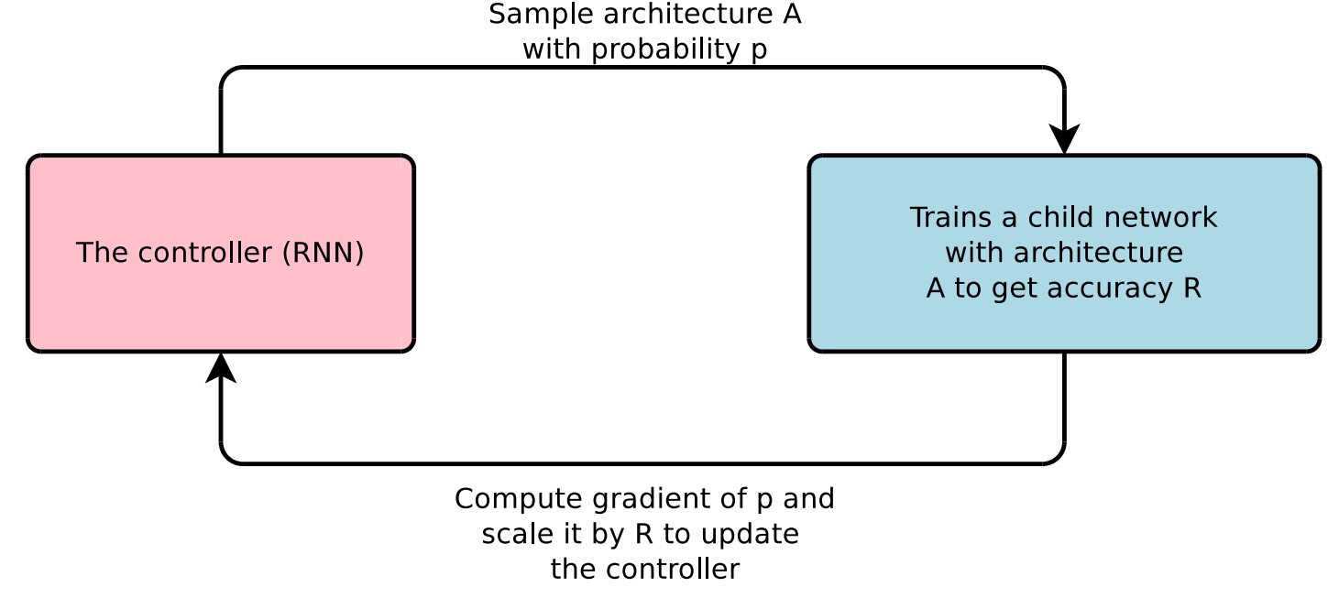
NAS with Reinforcement Learning
ICLR, 2017
Notes:
Explain reinforcement learning,
In the domain of NAS, we have an RNN controller (agent), and a set of child networks (environment)
Accuracy of the childnetwork is used as a reward to update the controller

Slide 18
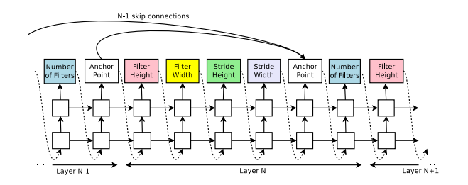
NAS with Reinforcement Learning
The structure and connectivity of a neural network can be specified by a variable-length string.
Use a recurrent network (the controller) to generate such a string.
Train the “child network” specified by the string.
Update the controller with REINFORCE, using the validation accuracy as the reward signal.
Notes:
How the controller RNN generates architectural hyperparameters of a CNN.
The parameters of the controller RNN are optimized in order to maximize the expected validation accuracy of the proposed architectures.
Anchor Points: Decide which previous layers should be connected
Policy gradient method to update the parameters.

Slide 19
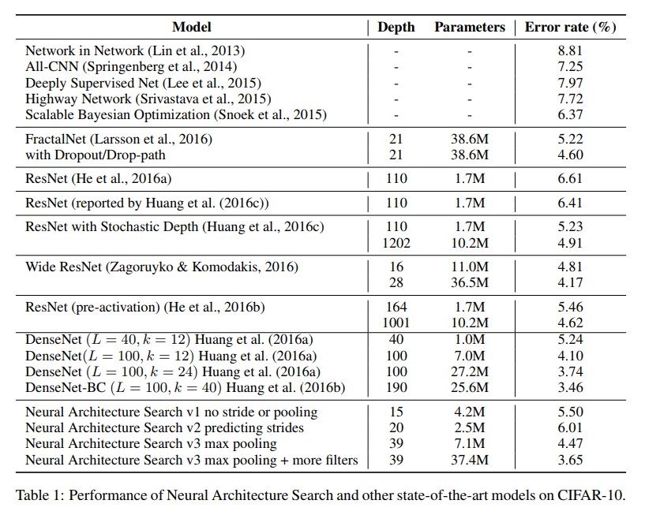
NAS with Reinforcement Learning – Results
500 GPUs x 30 = 1500~2000 GPU days
Notes:
One caveat to NAS: Gpu 500x 30 days = 1500days ~2000 days

Slide 20
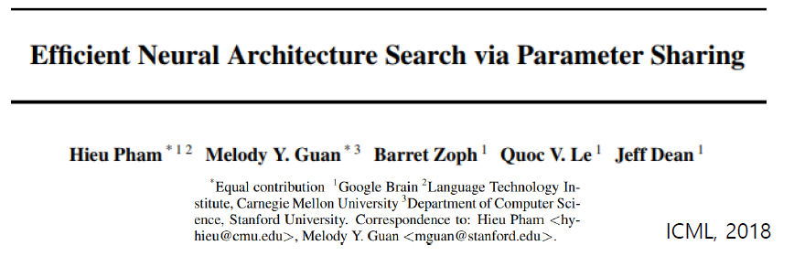
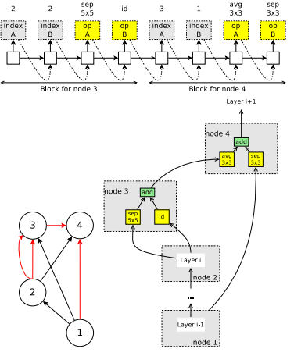
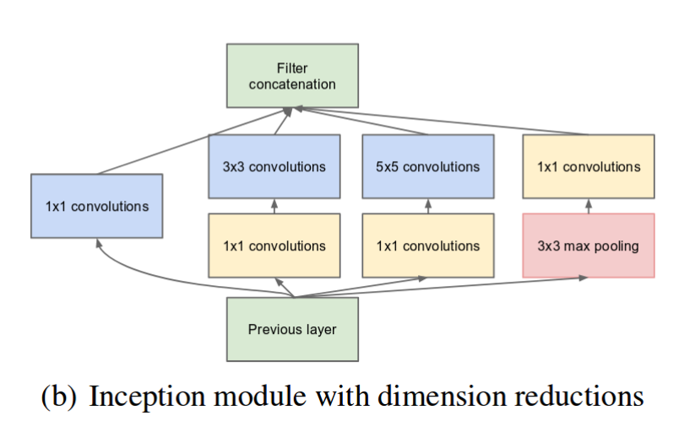
Reinforcement Learning + Efficiency (ENAS)
Improve the efficiency of NAS by forcing all child networks to share weights.
Design a “cell” instead of the entire architecture.
Notes:
Build a directed acyclic graph which can represent all possible child networks in the search space by activating/deactivating nodes and edges;
Depending on the child network, only some of the edges will be activated;
once the weights assigned to each activated edge are learned, they are never re-initialized.
Cell: inception module, build a cell and stack them to make a deep network

Slide 21
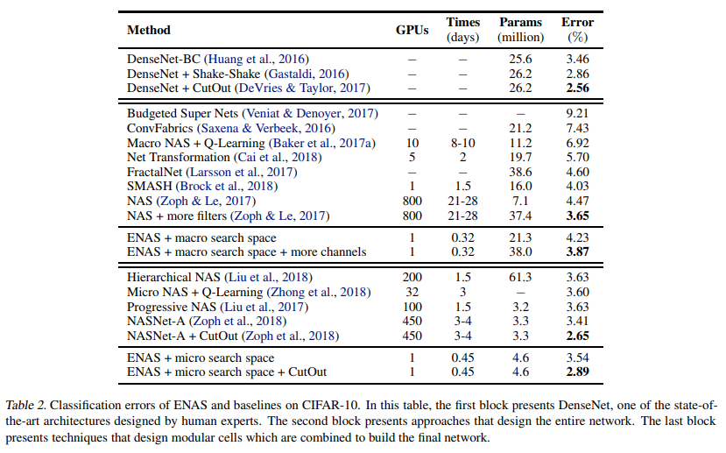

ENAS – Training Results
Notes:
Micro v. macro search space

Slide 22
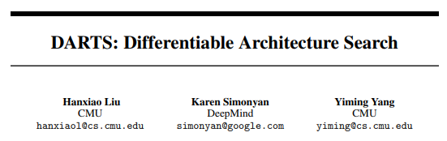
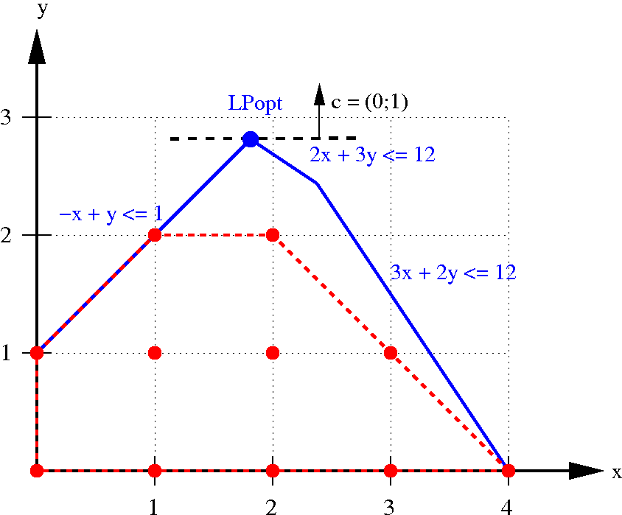
Differentiable Architecture Search (DARTS)
arXiv, 2018
Previous Works: Apply evolutionary algorithm or reinforcement learning over a discrete & non-differentiable search space.
Through continuous relaxation of architecture representation, allow efficient search of the architecture using gradient descent.

Slide 23
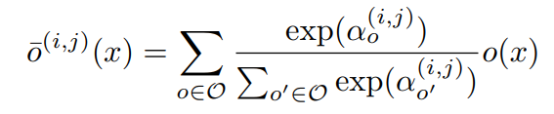
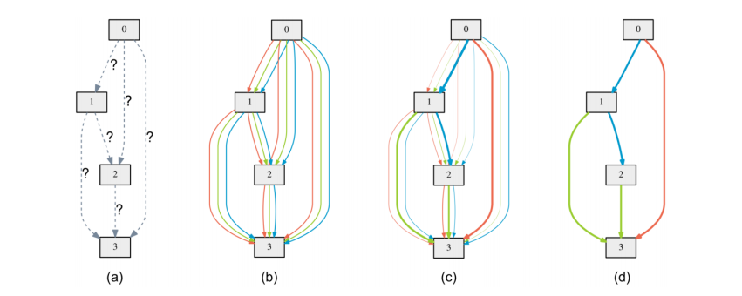
DARTS – Continuous Relaxation
Relax the categorical choice of a particular operation as a softmax over all possible operations:
a = 0.7
a = 0.2
a = 0.1
Notes:
All possible operation 에 대한 softmax를 취한 값으로 weight alpha 를 줌

Slide 24
DARTS – Results
Notes:
Cutout -> 이미지의 일부분을 잘라내서 data augmentation 테크닉

Slide 25
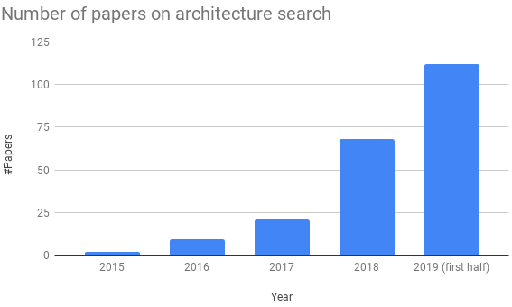



Rapid Growth of AutoML

Slide 26
Table of Contents
Introduction: Why AutoML?
Neural Architecture Search Techniques
Evolutionary Algorithm
Reinforcement Learning
Gradient- Based Optimization
Applications of NAS
Computer Vision
Auto-DeepLab [Image Segmentation]
NAS-FPN [Object Detection]
AutoGAN [Image Generation]
Network Size Reduction
Platform-aware Network Design
Neural Network Pruning
Conclusion

Slide 27
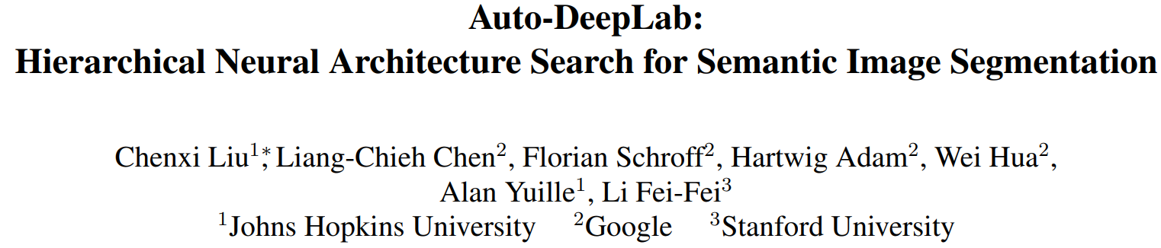
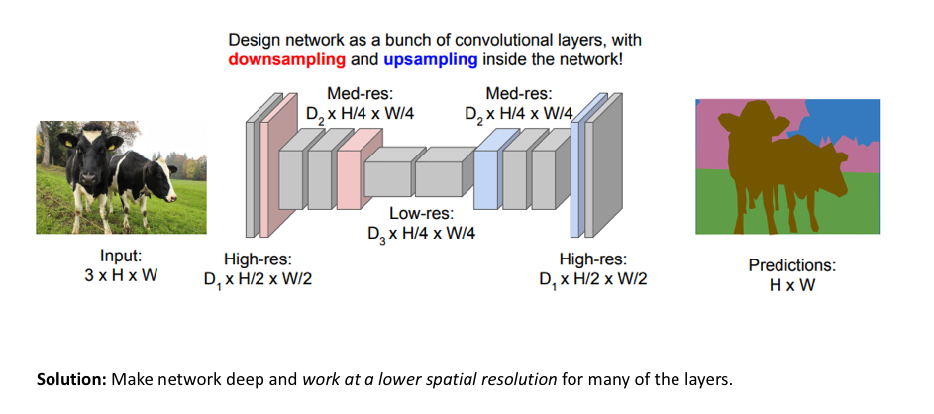
Auto-DeepLab [Image Segmentation]
CVPR, 2019
Key Challenge in Image Segmentation
Need to Maintain Image Resolution & Semantics
More relaxed and general search space
More efficient architecture search technique

Slide 28
Auto-DeepLab [Image Segmentation]
ICML, 2017
Problem
Proposed Solution
Relaxed Search Space
Efficient Search Algorithm
Hierarchical Search Space
Gradient-based Architecture Search

Slide 29
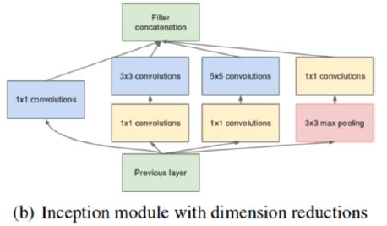
Cell-level Design vs. Hierarchical Design
Prediction
Cell 4
Cell 3
Cell 2
Cell-Level Design
Only design the cell
Fixed architecture backbone
Cell 1
Input

Slide 30
Cell-level Design vs. Hierarchical Design
Prediction
Cell 4
Cell 3
Cell 2
Hierarchical Design
Flexible cell structure and
Flexible architecture backbone
Cell 1
Input

Slide 31
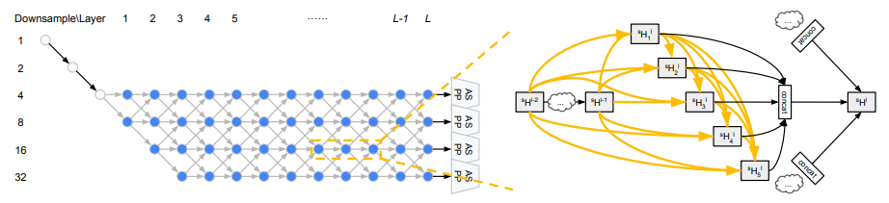
Search Space – Architecture Level
“Stem” Layers
Atrous Spatial Pyramid Pooling
Two consistent principles:
The spatial resolution of the next layer is either twice as large, or twice as small, remains the same.
The smallest spatial resolution is downsampled by 32.

Slide 32
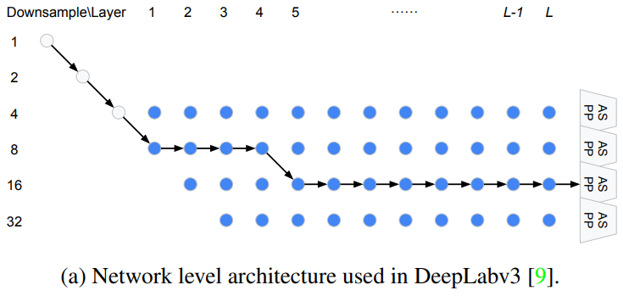
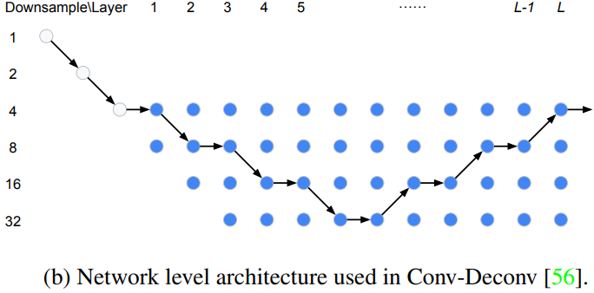
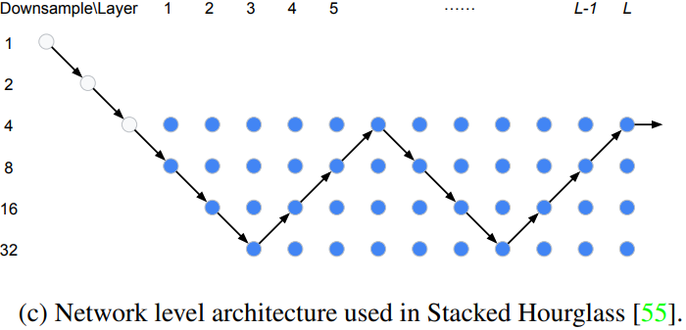
Representative Power of the Search Space
Image Segmentation Architectures

Slide 33
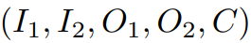
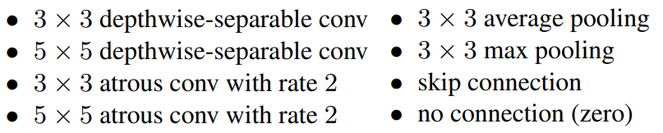
Search Space – Cell Level
Directed acyclic graph consisting of 5 blocks.
Each block can be represented using a tuple:
I: input tensor / O: layer type / C: combination method
Possible layer types:
Notes:
C is preset as element-wise multiplication

Slide 34
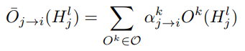
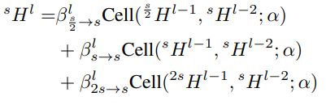
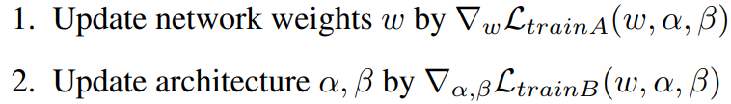
Putting it All Together
Yellow lines associated with:
Gray lines
associated with:
Split the training data into two disjoint sets: trainA and trainB
Alternating optimization:

Slide 35
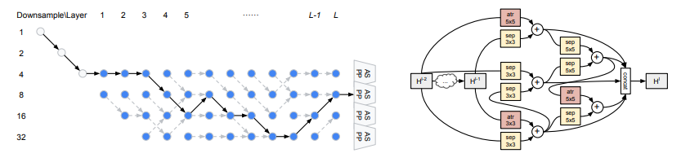
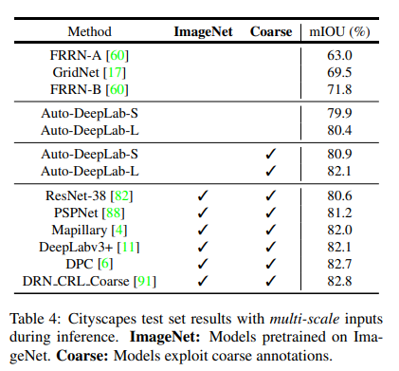
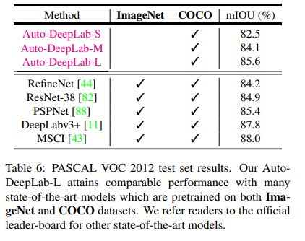
Auto-DeepLab Searched Architecture & Results
Architecture Level
Cell Level

Slide 36
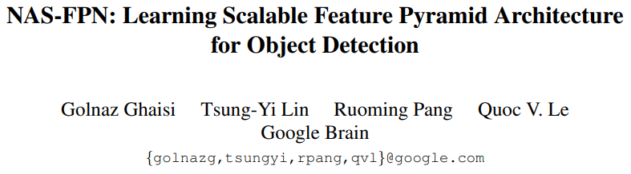
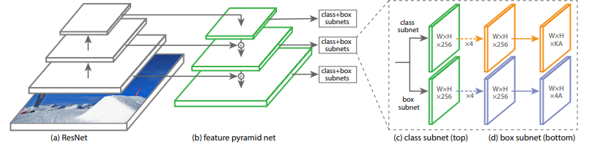
NAS-FPN [Object Detection]
CVPR, 2019
RetinaNet Architecture
Automatically design feature pyramid net (FPN)

Slide 37


Search Space “Merging Cell”
First feature layer from candidates.
Second feature layer from candidates (w/o replacement).
Output feature resolution
Binary op to combine 1 and 2
Advantages
Covers all cross-scale connections
Identical input and output feature levels -> can be applied repeatedly.
Notes:
어떻게 identical 하게 fix 하는지

Slide 38


NAS-FPN Searched Architecture
Connection between high resolution input and output feature layers.
Both top-down and bottom-up connections.
Better feature reuse.
Search Progress
Searched Architecture

Slide 39

NAS-FPN Results
*NAS-FPNLite: replace convolution with depthwise separable convolution.
Notes:
What is dropblock?

Slide 40


Scalability of NAS-FPN
Larger FPN architecture results in improved performance.
NAS-FPN can be applied to different backbone architectures / feature dimensions.
Notes:
바닐라 fpn 그림 추가

Slide 41


AutoGAN [Image Generation]
ICCV, 2019
Difficulties in GAN Training
Non-convergence;
Mode collapse;
Diminished gradient;
Unbalanced generator & discriminator…
GAN Architecture

Slide 42
How to build and jointly train both networks?
ICML, 2017
Dynamic Parameter Resetting
The variance of the training loss becomes very small when mode collapse happens.
SD of stored training losses < pre-defined threshold
Terminate GAN training and initialize the model.
Only search for Generator, while growing Discriminator
Pre-fixed discriminator
Incur imbalance between Generator and Discriminator.
Joint Search for G & D
Two-way NAS further deteriorates the instability of GAN training.

Slide 43

Search Space
Skip connection
Upsampling operation
Bilinear upsampling
Nearest neighbor upsampling
Stride 2 deconvolution
Normalization type
Batch normalization
Instance normalization
No normalization
Convolution block type
In-cell shortcut
l
n
j
k
m
Notes:
Skip: binary value indicating whether the current s-th cell takes a skip connection from previous cells

Slide 44


Training AutoGAN
RNN Controller
REINFORCE + entropy term
F_{DR} : flag for dynamic resetting

Slide 45
Training AutoGAN
AutoGAN searches for 90 iterations.
GAN is trained for 15 epochs
Inception score: proxy task to choose top 5 architectures
RNN Controller is trained for 30 steps.

Slide 46
Training AutoGAN
F_{DR} : set as 1e-3
SD of the stored training losses < F_{DR} (1e-3)
Terminate GAN training.
Initialize parameters.
RNN controller stays the same.

Slide 47



Validation of Proxy Task
Real evaluation vs.
Proxy performance
Inception score vs.
FID

Slide 48

AutoGAN Searched Architecture
Observations
Pre-activation convolution >> Post-activation convolution
Nearest neighbor/bilinear upsample >> deconv.
No normalization.
In favor of denser skip connections.

Slide 49



AutoGAN Results

Slide 50
Summary
 | Search Space | Search Strategy | Performance Estimation | Algorithm Runtime
Auto-DeepLab | Refer to pg. 34 | Gradient-based Optimization | N/A | 3 P100 GPU days (Cityscapes)
NAS-FPN | Refer to pg. 37 | Reinforcement Learning | Average Precision (AP) after 10 epochs | 8 2080 Ti GPU days (COCO)
AutoGAN | Refer to pg. 43 | Reinforcement Learning | Inception Score (IS) after 15 epochs | 43 hours (CIFAR-10)

Slide 51
Table of Contents
Introduction: Why AutoML?
Neural Architecture Search Techniques
Evolutionary Algorithm
Reinforcement Learning
Gradient- Based Optimization
Applications of NAS
Computer Vision
Auto-DeepLab [Image Segmentation]
NAS-FPN [Object Detection]
AutoGAN [Image Generation]
Network Size Reduction
Platform-aware Network Design
Neural Network Pruning
Conclusion

Slide 52


Platform-aware AutoML
Latency,
FLOPs…
RNN Controller
Tailored Architecture

Slide 53
Papers in Platform-aware AutoML
Authors | Title | Publication | Year
Dong et al. | PPP-Net: Platform-aware progressive search for pareto-optimal neural architectures. | ICLR Workshop | 2018
Cai et al. | ProxylessNAS: Direct Neural Architecture Search on Target Task and Hardware | ICLR | 2019
Tan et al. | MnasNet: Platform-Aware Neural Architecture Search for Mobile | CVPR | 2019
Wu et al. | FBNet: Hardware-Aware Efficient ConvNet Design via Differential Neural Architecture Search | CVPR | 2019
Elsken et al. | Efficient Multi-Objective Neural Architecture Search via Lamarckian Evolution. | ICLR | 2019
Cai et al. | On-Device Image Classification with Proxyless Neural Architecture Search and Quantization-Aware Fine-tuning | ICCV Workshop | 2019

Slide 54

Network Pruning via AutoML

Slide 55
Papers in Network Pruning via AutoML
Authors | Title | Publication | Year
He et al. | AMC: AutoML for Model Compression and Acceleration on Mobile Devices | ECCV | 2018
Xiao et al. | AutoPrune: Automatic Network Pruning by Regularizing Auxiliary Parameters | NeurIPS | 2019
Dong and Yang. | Network Pruning via Transformable Architecture Search | NeurIPS | 2019
Zhao and Luk. | Efficient Structured Pruning and Architecture Searching for Group Convlution | ICCV Workshop | 2019
Li et al. | Partial Order Pruning: for Best Speed/Accuracy Trade-off in Neural Architecture Search | CVPR | 2019

Slide 56

Imminent Future?

Slide 57
Limitations
No better than random search;
Lack of reproducibility;
Overfitting on a specific dataset – little transferability;
Experimental results <-> Actual results;
Domains outside computer vision;
Algorithmic innovation;

